Slide 1

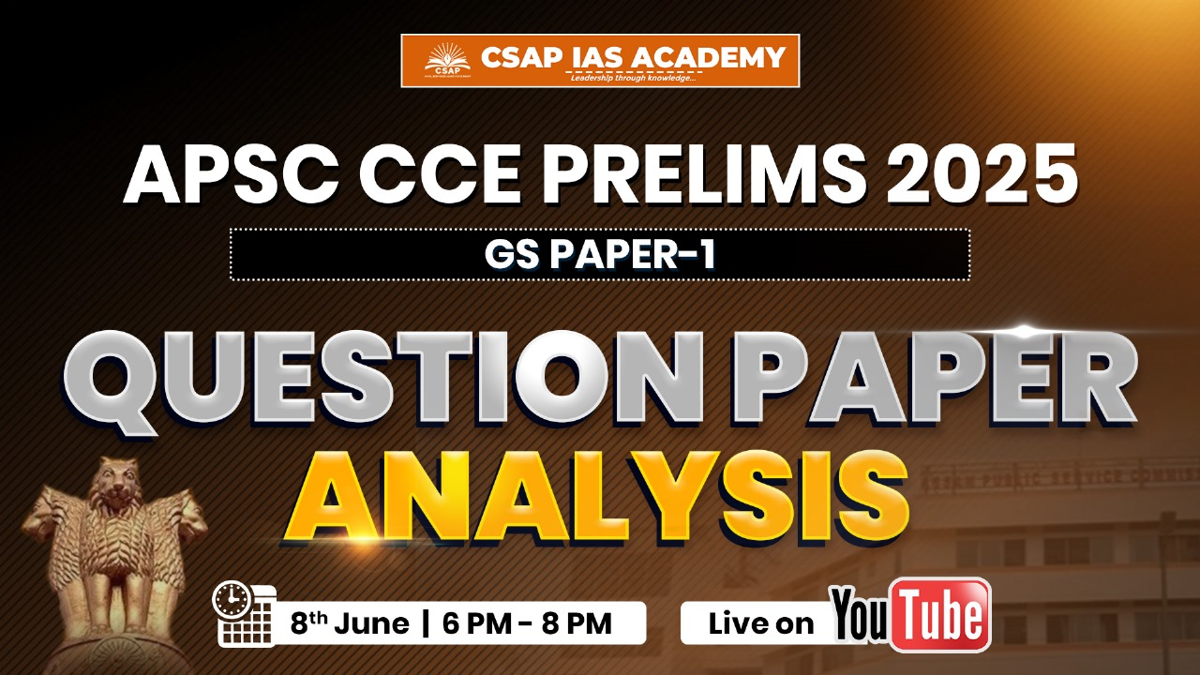

For analysis pdf, follow:
Telegram Channel

Slide 2


For analysis pdf, follow:
Telegram Channel

Slide 3
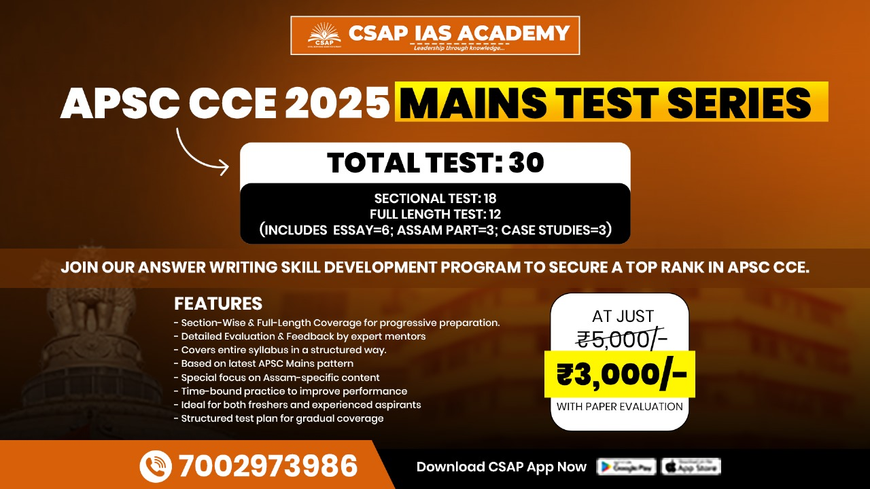
For analysis pdf, follow:
Telegram Channel

Slide 4
APSC Prelims 2025 Full Paper Analysis
GS PAPER 1
SET C

Slide 5
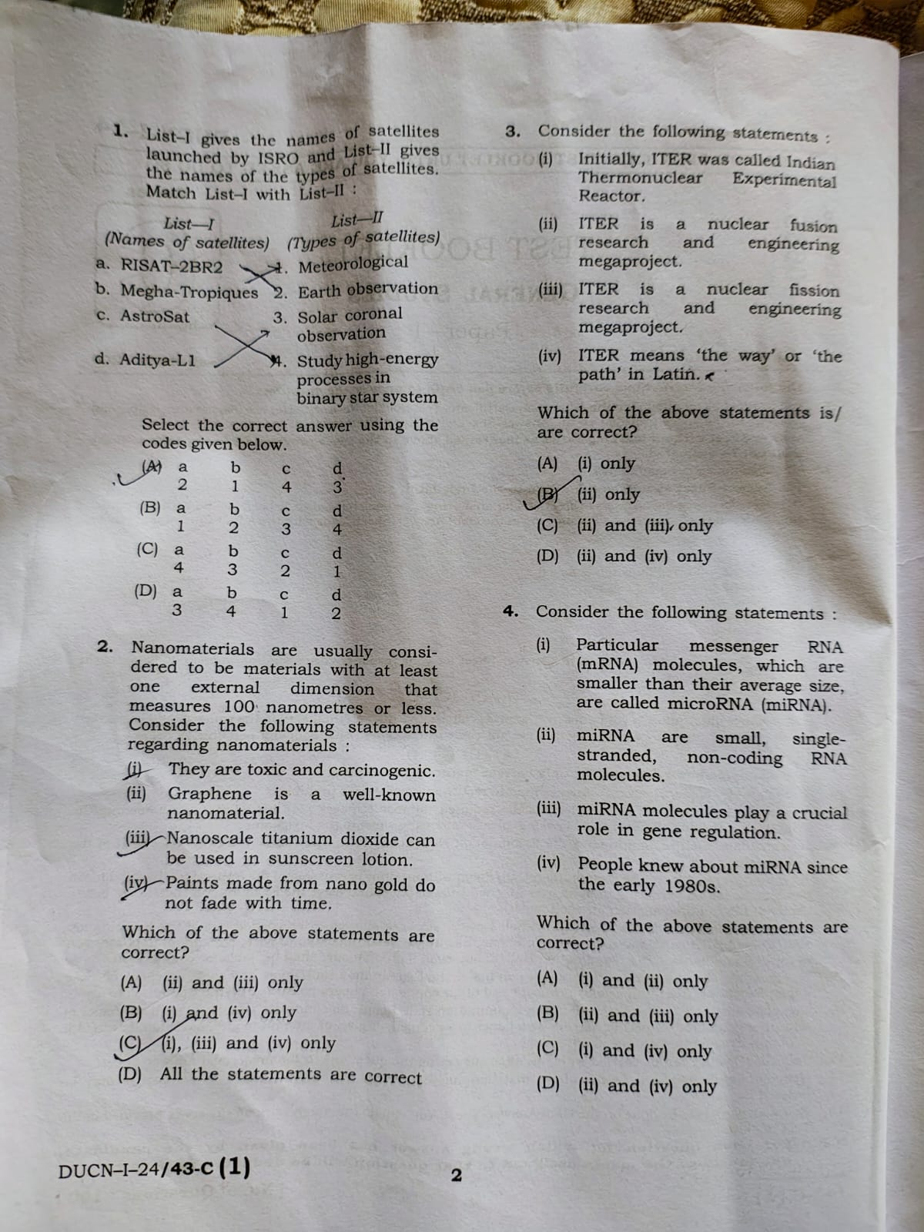
APSC Prelims 2025 Full Paper Analysis | GS Paper 1
Question
Explanation
Ans: A

Slide 6
APSC Prelims 2025 Full Paper Analysis | GS Paper 1
Question
Explanation
Ans: D

Slide 7
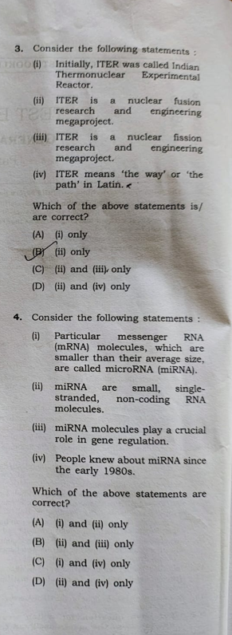
APSC Prelims 2025 Full Paper Analysis | GS Paper 1
Question
Explanation
Ans: B

Slide 8
APSC Prelims 2025 Full Paper Analysis | GS Paper 1
Question
Explanation
Ans: A

Slide 9
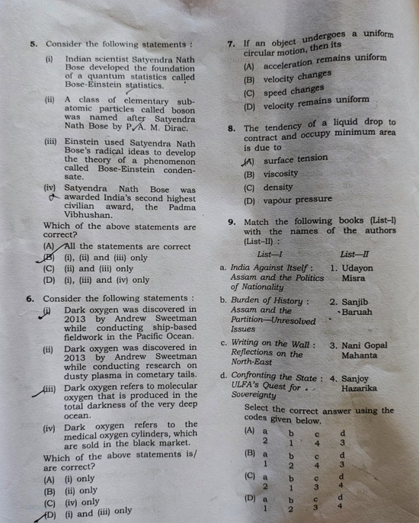
APSC Prelims 2025 Full Paper Analysis | GS Paper 1
Question
Explanation
Ans: A

Slide 10
APSC Prelims 2025 Full Paper Analysis | GS Paper 1
Question
Explanation
Ans: D

Slide 11

APSC Prelims 2025 Full Paper Analysis | GS Paper 1
Question
Explanation
Ans: B

Slide 12
APSC Prelims 2025 Full Paper Analysis | GS Paper 1
Question
Explanation
Ans: A

Slide 13
APSC Prelims 2025 Full Paper Analysis | GS Paper 1
Question
Explanation
Ans: A

Slide 14
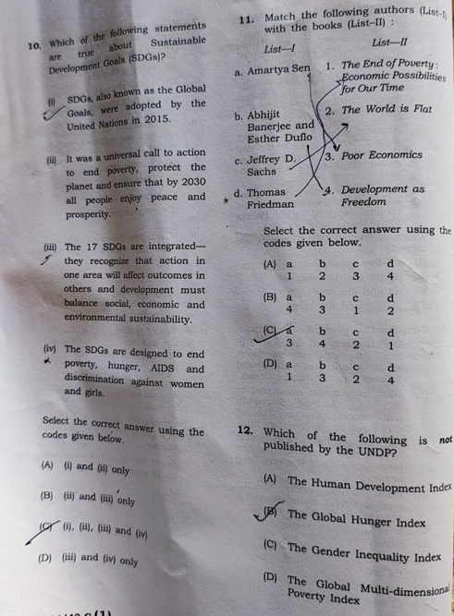
APSC Prelims 2025 Full Paper Analysis | GS Paper 1
Question
Explanation
Ans: C

Slide 15
APSC Prelims 2025 Full Paper Analysis | GS Paper 1
Question
Explanation
Ans: B

Slide 16
APSC Prelims 2025 Full Paper Analysis | GS Paper 1
Question
Explanation
Ans: B
https://hdr.undp.org/

Slide 17
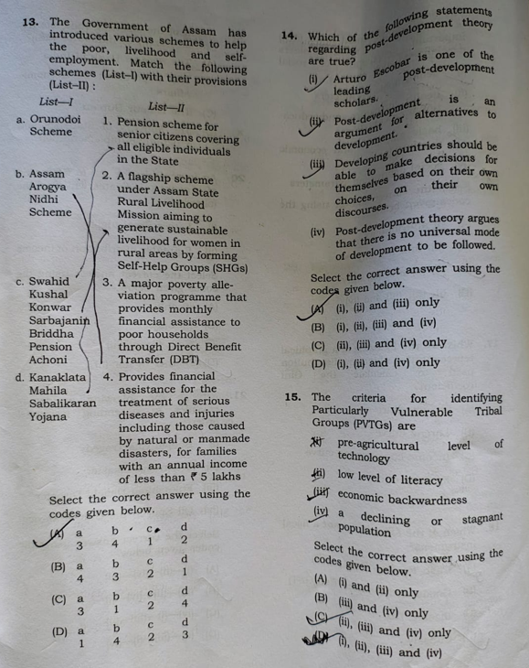
APSC Prelims 2025 Full Paper Analysis | GS Paper 1
Question
Explanation
Ans: A

Slide 18
APSC Prelims 2025 Full Paper Analysis | GS Paper 1
Question
Explanation
Ans: B
https://shorturl.at/Bcms9

Slide 19
APSC Prelims 2025 Full Paper Analysis | GS Paper 1
Question
Explanation
Ans: D - All the statements are correct
https://socialwelfare.vikaspedia.in/viewcontent/social-welfare/scheduled-tribes-welfare/particularly-vulnerable-tribal-groups?lgn=en

Slide 20
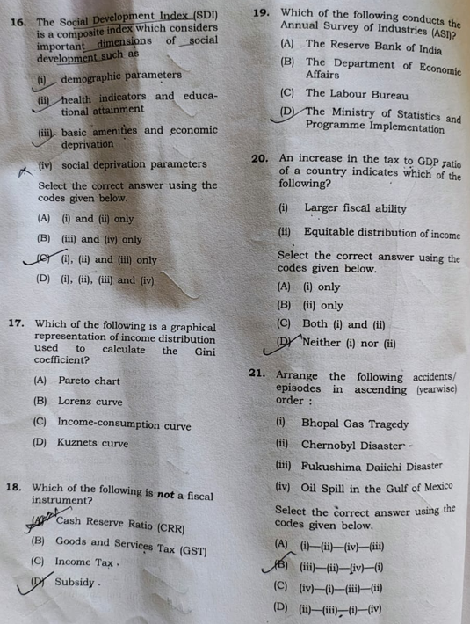
APSC Prelims 2025 Full Paper Analysis | GS Paper 1
Question
Explanation
Ans: C
All of the mentioned parameters are discussed.

Slide 21
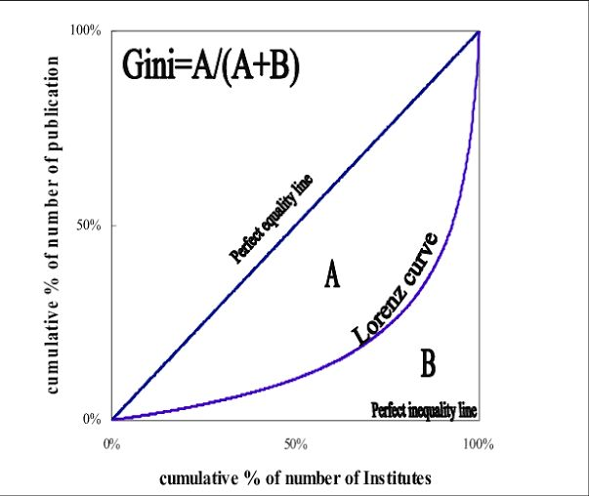
APSC Prelims 2025 Full Paper Analysis | GS Paper 1
Question
Explanation
Ans: B

Slide 22
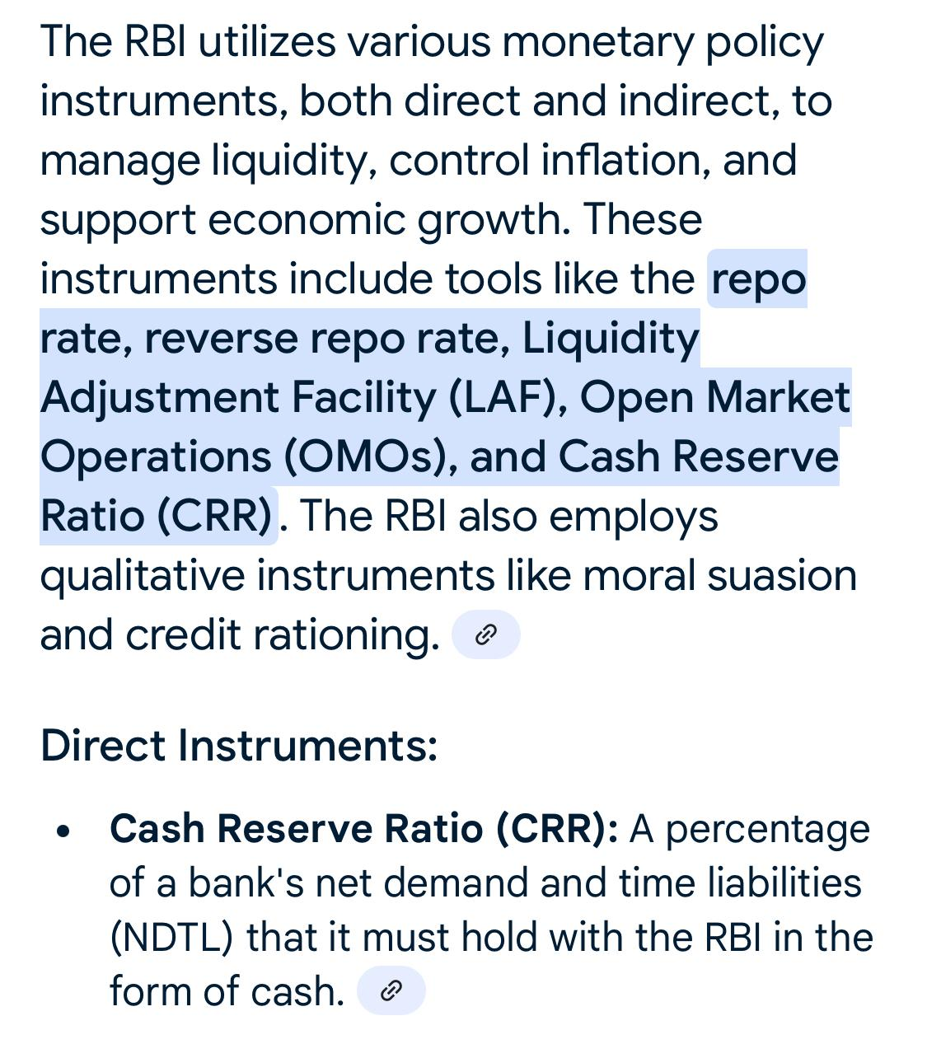
APSC Prelims 2025 Full Paper Analysis | GS Paper 1
Question
Explanation
Ans: A

Slide 23
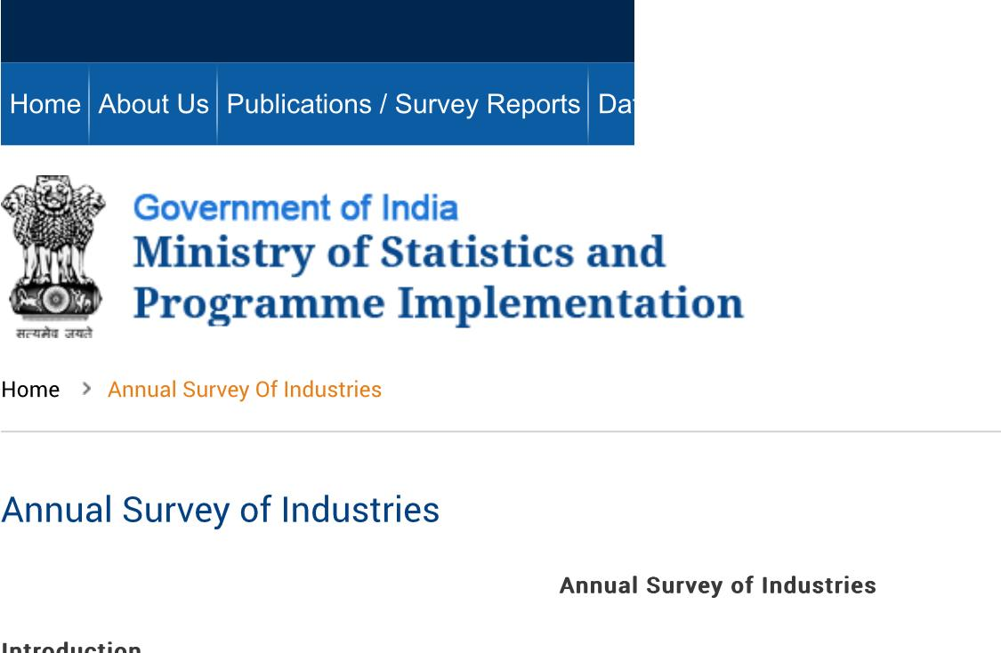
APSC Prelims 2025 Full Paper Analysis | GS Paper 1
Question
Explanation
Ans: D

Slide 24
APSC Prelims 2025 Full Paper Analysis | GS Paper 1
Question
Explanation
Ans: A
UPSC PYQ

Slide 25
APSC Prelims 2025 Full Paper Analysis | GS Paper 1
Question
Explanation
Ans: A
Bhopal gas tragedy: 2 December 1984
Chernobyl disaster: 26 April 1986
Fukushima daiichi disaster: 11 March 2011
Oil spill in the gulf of mexico: 20 April 2010

Slide 26
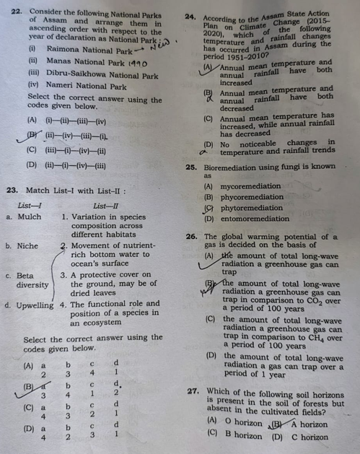
APSC Prelims 2025 Full Paper Analysis | GS Paper 1
Question
Explanation
Ans: B
raimona national park: June 5, 2021
manas national park: 1990
dibru saikhowa national park: 1999
nameri national park: 1998

Slide 27
APSC Prelims 2025 Full Paper Analysis | GS Paper 1
Question
Explanation
Ans: B
Mulch: A mulch is a layer of material applied to the surface of soil.
Niche: refers to the role or function of a species within its ecosystem
Beta diversity: a measure in ecology that describes the difference in species composition between different ecological communities or habitats, essentially comparing the species makeup of one area to another
upwelling: a phenomenon where wind-driven ocean currents cause deep, cold, nutrient-rich water to rise to the surface, replacing warmer, nutrient-depleted surface water

Slide 28
APSC Prelims 2025 Full Paper Analysis | GS Paper 1
Question
Explanation
Ans: C
The Assam State Action Plan on Climate Change (SAPCC), published in 2015, outlines strategies for adapting to and mitigating climate change impacts in the state. It recognizes the unique vulnerabilities of Assam to climate change, including rising temperatures, increased rainfall intensity, and potential flood risks.

Slide 29
APSC Prelims 2025 Full Paper Analysis | GS Paper 1
Question
Explanation
Ans: A
Phytoremediation is a cost-effective, eco-friendly approach to environmental cleanup that uses plants to remove, detoxify, or immobilize contaminants from soil, water, or air.
Bioremediation broadly refers to any process wherein a biological system (typically bacteria, microalgae, fungi in mycoremediation, and plants in phytoremediation), living or dead, is employed for removing environmental pollutants from air, water, soil etc.

Slide 30
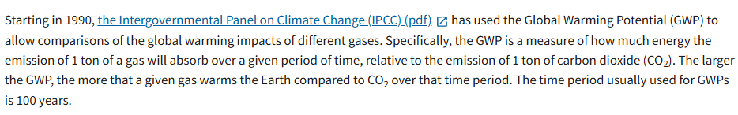
APSC Prelims 2025 Full Paper Analysis | GS Paper 1
Question
Explanation
Ans: B

Slide 31
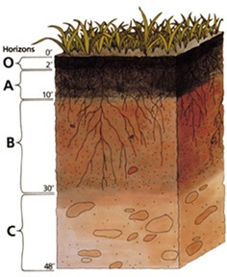
APSC Prelims 2025 Full Paper Analysis | GS Paper 1
Question
Explanation
Ans: A
The O horizon is composed of accumulated organic matter like fallen leaves and decomposing wood, which is prevalent in forested areas. However, agricultural practices like plowing regularly disturb and bury organic matter, preventing the formation of a distinct O horizon.

Slide 32
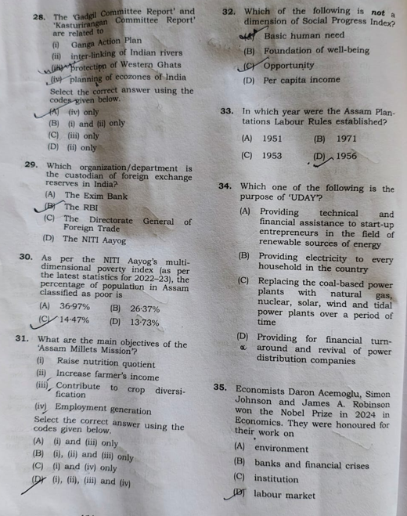
APSC Prelims 2025 Full Paper Analysis | GS Paper 1
Question
Explanation
Ans: C
The Gadgil Committee Report and the Kasturirangan Committee Report are both related to the conservation and sustainable development of the Western Ghats, a UNESCO World Heritage Site and one of India's most ecologically sensitive regions.

Slide 33
APSC Prelims 2025 Full Paper Analysis | GS Paper 1
Question
Explanation
Ans: B
The Reserve Bank of India, is the custodian of the country's foreign exchange reserves and is vested with the responsibility of managing their investment.

Slide 34
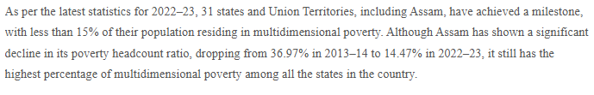
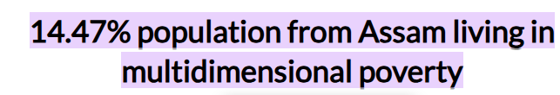
APSC Prelims 2025 Full Paper Analysis | GS Paper 1
Question
Explanation
Ans: C

Slide 35
APSC Prelims 2025 Full Paper Analysis | GS Paper 1
Question
Explanation
Ans: D
The Assam Millets Mission (AMM), launched in 2023, is part of the National Millets Mission (NMM) and aims to promote the cultivation, consumption, and commercialization of nutri-cereals (millets) in Assam. The mission aligns with the International Year of Millets (2023) declared by the UN and India’s push to revive millets as "Shree Anna" (superfood).

Slide 36
APSC Prelims 2025 Full Paper Analysis | GS Paper 1
Question
Explanation
Ans: D
The Social Progress Index (SPI) measures the extent to which countries provide for the social and environmental needs of their citizens.
Dimensions:
Basic Human Needs, Foundations of Wellbeing, and Opportunity.

Slide 37
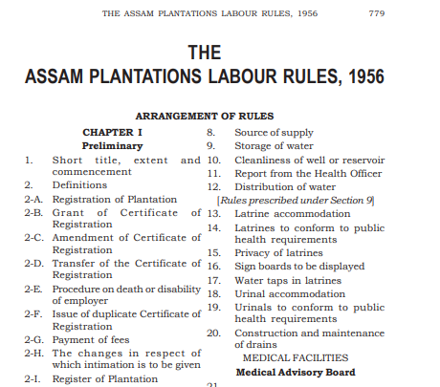
APSC Prelims 2025 Full Paper Analysis | GS Paper 1
Question
Explanation
Ans: D

Slide 38
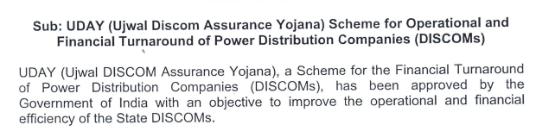
APSC Prelims 2025 Full Paper Analysis | GS Paper 1
Question
Explanation
Ans: D

Slide 39

APSC Prelims 2025 Full Paper Analysis | GS Paper 1
Question
Explanation
Ans: C

Slide 40
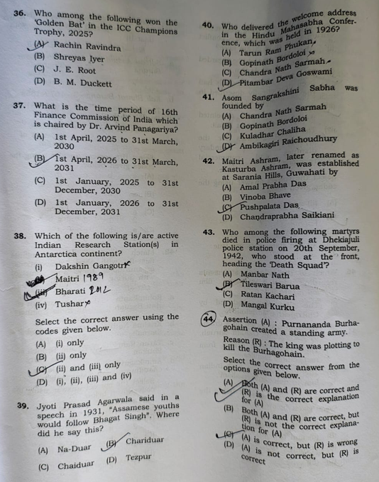
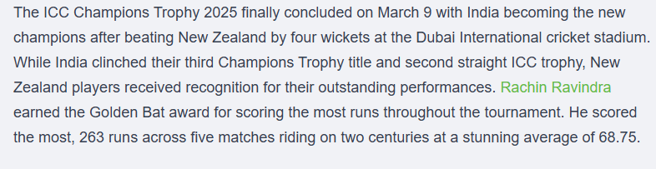
APSC Prelims 2025 Full Paper Analysis | GS Paper 1
Question
Explanation
Ans: A

Slide 41
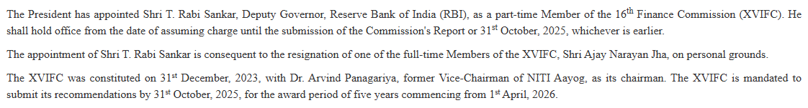
APSC Prelims 2025 Full Paper Analysis | GS Paper 1
Question
Explanation
Ans: B

Slide 42
APSC Prelims 2025 Full Paper Analysis | GS Paper 1
Question
Explanation
Ans: C

Slide 43
APSC Prelims 2025 Full Paper Analysis | GS Paper 1
Question
Explanation
Ans: B

Slide 44
APSC Prelims 2025 Full Paper Analysis | GS Paper 1
Question
Explanation
Ans: A

Slide 45
APSC Prelims 2025 Full Paper Analysis | GS Paper 1
Question
Explanation
Ans: D
The Asom Sangrakshini Sabha, meaning "Assam Preservation Council," was founded by Ambikagiri Raichoudhury in 1926. Its purpose was to promote and protect the rights and interests of Assamese people, particularly concerning issues like unrestricted immigration and settlement in the Assam Valley. The organization played a role in advocating for the interests of the Assamese population during a period of significant social and political changes in Assam.

Slide 46
APSC Prelims 2025 Full Paper Analysis | GS Paper 1
Question
Explanation
Ans: A
Amalprabha's father H.K. Das donated the land required for the establishment of the Ashram, and it was established in the Sarania Hills, Guwahati.

Slide 47

APSC Prelims 2025 Full Paper Analysis | GS Paper 1
Question
Explanation
Ans: A

Slide 48
APSC Prelims 2025 Full Paper Analysis | GS Paper 1
Question
Explanation
Ans: B
Impressed by the Company army's discipline and organization during Captain Welsh's expedition, and finding it difficult to recruit soldiers through kheldars, Purnananda undertook measures to create a regular standing army.

Slide 49
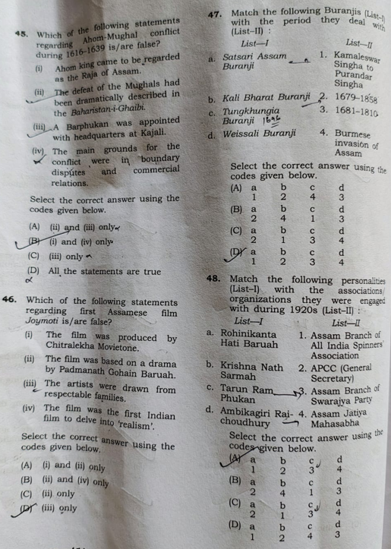
APSC Prelims 2025 Full Paper Analysis | GS Paper 1
Question
Explanation
Ans: D

Slide 50
APSC Prelims 2025 Full Paper Analysis | GS Paper 1
Question
Explanation
Ans: C
Joymoti is a 1935 Indian film widely considered to be the first Assamese film ever made. Based on Lakshminath Bezbaroa's play about the 17th-century Ahom princess Joymoti Konwari

Slide 51
APSC Prelims 2025 Full Paper Analysis | GS Paper 1
Question
Explanation
Ans: D
"Kali Bharat Buranji" is a metrical chronicle of Assam, authored by Dutiram Hazarika, a prominent Assamese writer. This buranji, or chronicle, specifically focuses on the period from 1679 to 1858
Tungkhungia Buranji, also known as "A History of Assam, 1681-1826 A.D.," is a significant historical chronicle focusing on the Tungkhungia dynasty of Ahom rulers in Assam.

Slide 52
APSC Prelims 2025 Full Paper Analysis | GS Paper 1
Question
Explanation
Ans: A
Ambikagiri Raichoudhury (played a key role in the Assam Jatiya Mahasabha, a political organization that advocated for Assamese rights and interests
Tarun Ram Phukan was a key figure in the Swaraj Party branch in Assam.

Slide 53
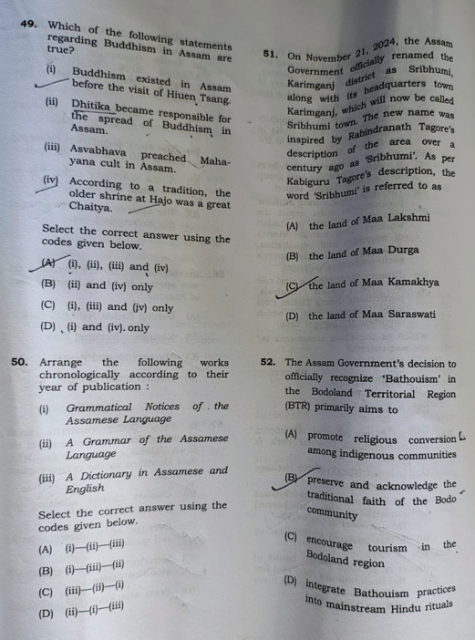
APSC Prelims 2025 Full Paper Analysis | GS Paper 1
Question
Explanation
Ans: A
Buddhism in Assam predates the visit of Hiuen Tsang. Literary and archaeological evidence
it is commonly believed that Thera Dhitika played a significant role in the spread of Buddhism in Assam, especially in the Kamrupa region during the reign of Emperor Ashoka.

Slide 54
APSC Prelims 2025 Full Paper Analysis | GS Paper 1
Question
Explanation
Ans: D
Grammatical notices of the Asamese language - Internet Archive 1848
"A Grammar of the Assamese Language" was published in 1839 by William Robinson.
The Dictionary written by Miles Bronson is a treasure to Assamese language. The Dictionary was written in 1867

Slide 55

APSC Prelims 2025 Full Paper Analysis | GS Paper 1
Question
Explanation
Ans: A

Slide 56
APSC Prelims 2025 Full Paper Analysis | GS Paper 1
Question
Explanation
Ans: B
Bathouism is the traditional faith of the Bodo people, primarily practiced in Assam and the foothills of Bhutan

Slide 57
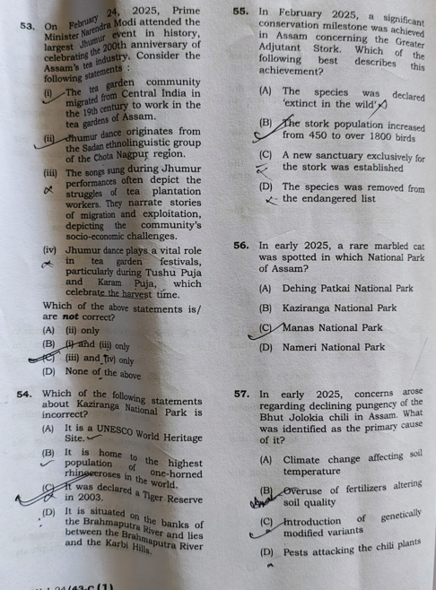
APSC Prelims 2025 Full Paper Analysis | GS Paper 1
Question
Explanation
Ans: C
The Tea Garden Community of Assam, also known as Tea Tribes or Adivasis, comprises descendants of indentured laborers brought from Central India to work in British tea plantations in the 19th and early 20th centuries. They originated from regions like Jharkhand, Odisha, Chhattisgarh, and West Bengal.

Slide 58
APSC Prelims 2025 Full Paper Analysis | GS Paper 1
Question
Explanation
Ans: C
Kaziranga National Park was officially declared a Tiger Reserve in 2006. Although it has been a protected area since 1905, its designation as a Tiger Reserve came later, following the increase in tiger population within the park.

Slide 59
APSC Prelims 2025 Full Paper Analysis | GS Paper 1
Question
Explanation
Ans: B
the Greater Adjutant Stork population in Assam has significantly increased. The "Hargila Army," a conservation movement led by Dr. Purnima Devi Barman, has played a crucial role in this positive trend.

Slide 60
APSC Prelims 2025 Full Paper Analysis | GS Paper 1
Question
Explanation
Ans: A
The Marbled Cat (Pardofelis marmorata) is a small wild cat native to the eastern Himalayas and Southeast Asia, known for its striking marbled-patterned fur. It's considered a rare and elusive species, with recent sightings in Dehing Patkai National Park in Assam, India, highlighting its conservation status.

Slide 61
APSC Prelims 2025 Full Paper Analysis | GS Paper 1
Question
Explanation
Ans: B
Overuse of chemical fertilisers, low-quality seeds, and hurried cultivation methods are eroding the pepper's trademark heat and aroma. Experts ...

Slide 62
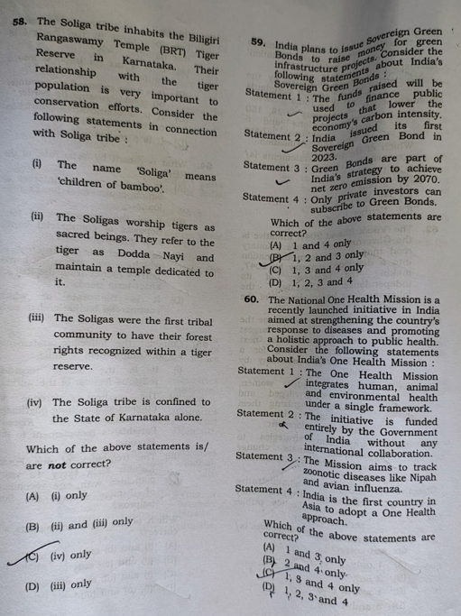
APSC Prelims 2025 Full Paper Analysis | GS Paper 1
Question
Explanation
Ans: C
The Soliga are an indigenous, forest-dwelling community primarily found in the Biligiri Rangana Hills (BR Hills) and nearby areas of Karnataka and Tamil Nadu

Slide 63
APSC Prelims 2025 Full Paper Analysis | GS Paper 1
Question
Explanation
Ans: B

Slide 64
APSC Prelims 2025 Full Paper Analysis | GS Paper 1
Question
Explanation
Ans: A

Slide 65
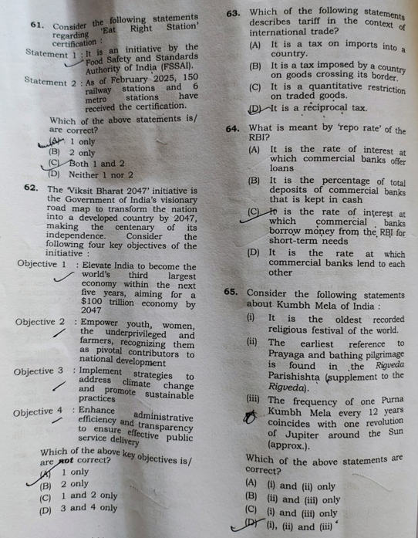
APSC Prelims 2025 Full Paper Analysis | GS Paper 1
Question
Explanation
Ans: A
No metro station has been allotted the certificate
Source: https://eatrightindia.gov.in/eatrightstation/#:~:text=Eat%20Right%20STATION%20:%20objective%20to,Toggle%20navigation

Slide 66
APSC Prelims 2025 Full Paper Analysis | GS Paper 1
Question
Explanation
Ans: A
Viksit Bharat 2047 initiative

Slide 67
APSC Prelims 2025 Full Paper Analysis | GS Paper 1
Question
Explanation
Ans: A
Basic economics
(https://www.investopedia.com/terms/t/tariff.asp)
And CSAP smartbook

Slide 68
APSC Prelims 2025 Full Paper Analysis | GS Paper 1
Question
Explanation
Ans: C
Repo rate
Basic economics
(Source: CSAP smartbook)
Repo Rate: The Repo Rate is the interest rate at which the Reserve Bank of India (RBI) loans money to commercial banks.
(https://www.pib.gov.in/PressNoteDetails.aspx?NoteId=154573&ModuleId=3)

Slide 69
APSC Prelims 2025 Full Paper Analysis | GS Paper 1
Question
Explanation
Ans: D
https://mahakumbh.in
Official website of Kumbha mela mentions all three statements
The doubt is about statement 1 (Recorded)

Slide 70
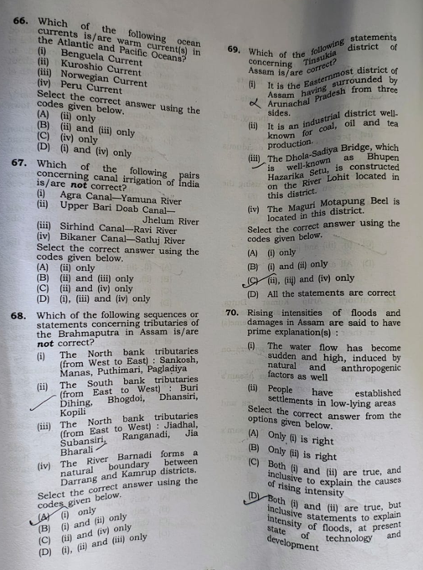
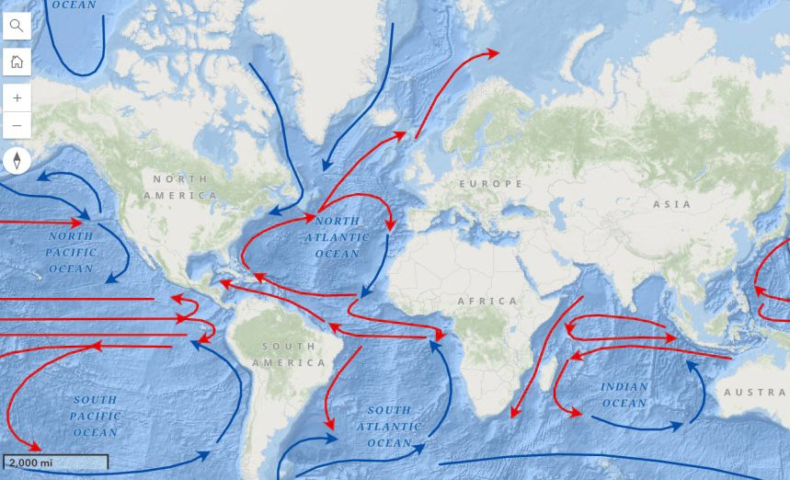
APSC Prelims 2025 Full Paper Analysis | GS Paper 1
Question
Explanation
Ans: B

Slide 71
APSC Prelims 2025 Full Paper Analysis | GS Paper 1
Question
Explanation
Ans: B
Upper Bari Doab canal is on Ravi river
Sirhind canal is on Sutlej river

Slide 72
APSC Prelims 2025 Full Paper Analysis | GS Paper 1
Question
Explanation
Ans: A
The North bank tributaries (from West to East): Sankosh, Manas, Puthimari, Pagladiya
Pagladiya river is in the west of Puthimari.

Slide 73
APSC Prelims 2025 Full Paper Analysis | GS Paper 1
Question
Explanation
Ans: D
All of these statements are correct

Slide 74
APSC Prelims 2025 Full Paper Analysis | GS Paper 1
Question
Explanation
Ans: D
APSC says the answer is A.

Slide 75
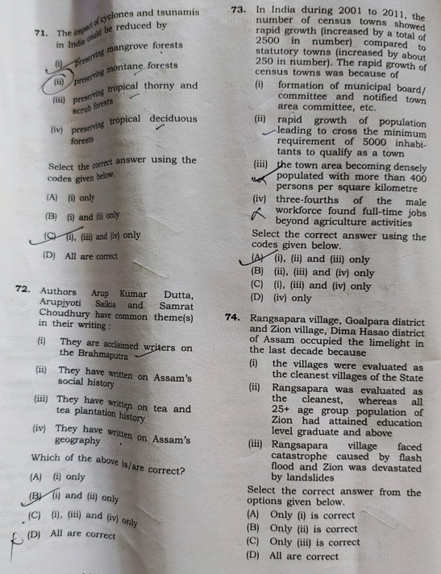
APSC Prelims 2025 Full Paper Analysis | GS Paper 1
Question
Explanation
Ans: A

Slide 76
APSC Prelims 2025 Full Paper Analysis | GS Paper 1
Question
Explanation
Ans: B
APSC : A

Slide 77
APSC Prelims 2025 Full Paper Analysis | GS Paper 1
Question
Explanation
Ans: A

Slide 78
APSC Prelims 2025 Full Paper Analysis | GS Paper 1
Question
Explanation
Ans: D
APSC: A

Slide 79
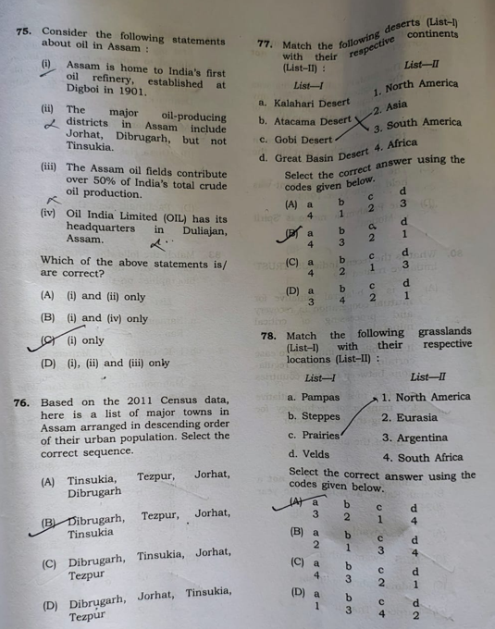
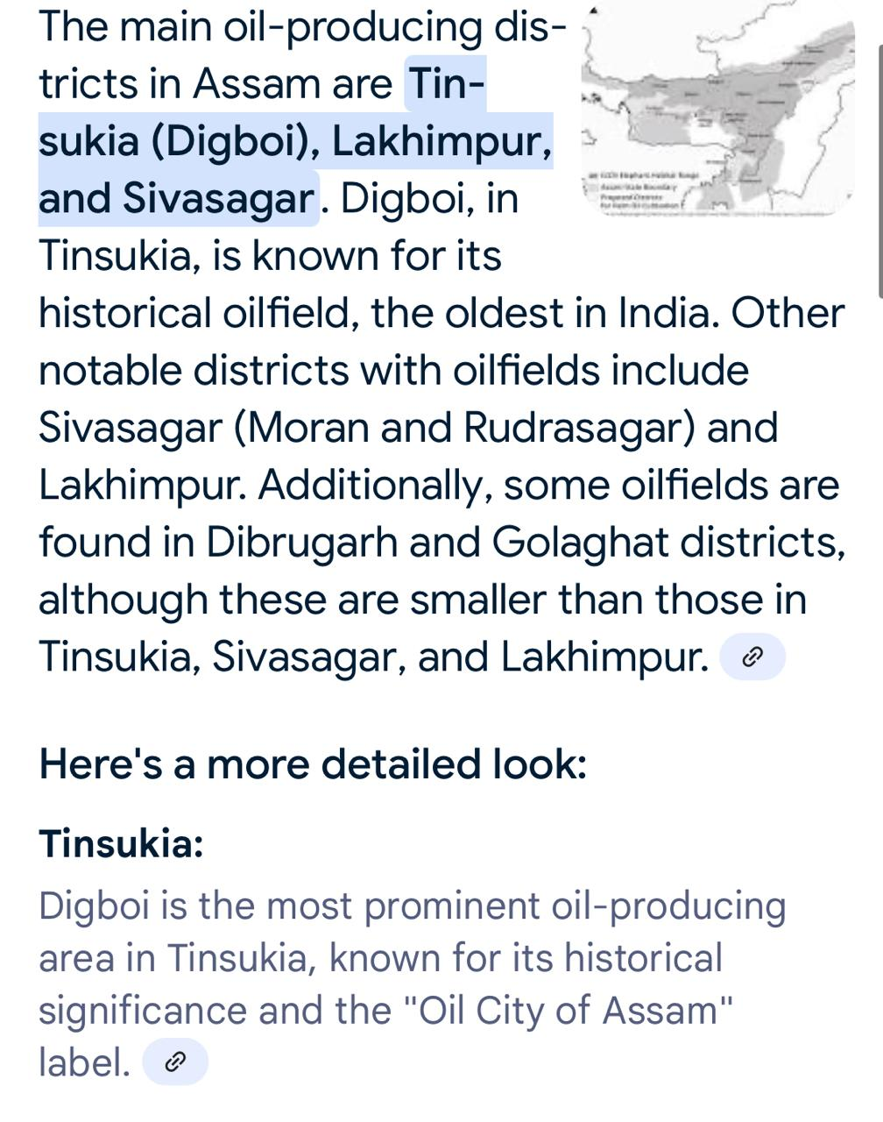
APSC Prelims 2025 Full Paper Analysis | GS Paper 1
Question
Explanation
Ans: B
https://ahecl.in/portlets/assam-oil

Slide 80
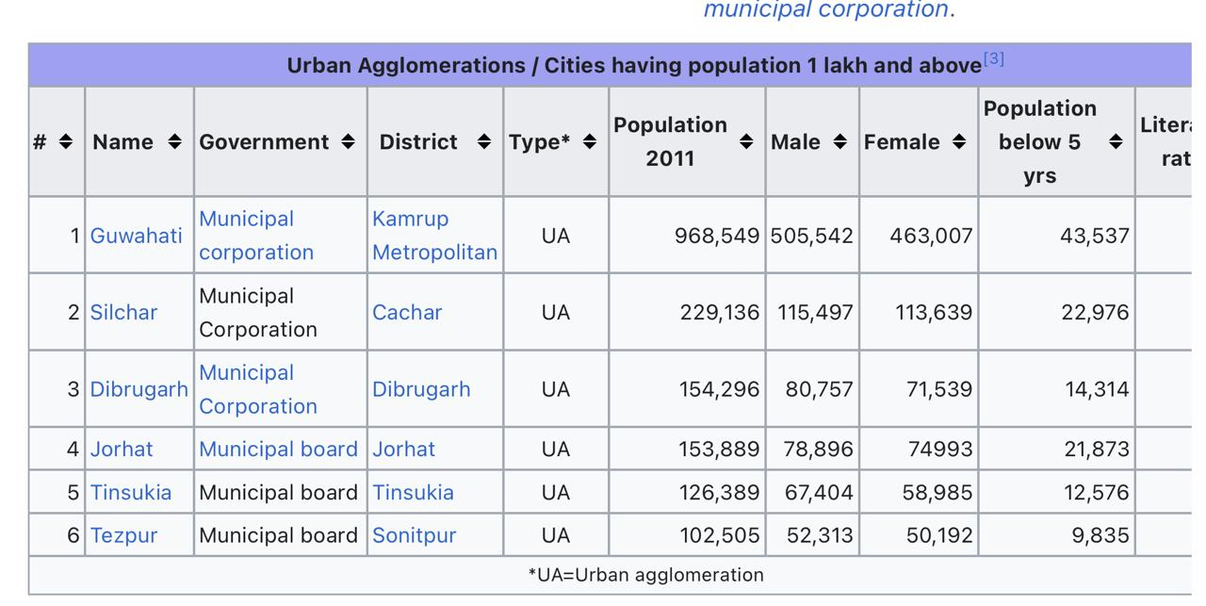
APSC Prelims 2025 Full Paper Analysis | GS Paper 1
Question
Explanation
Ans: D

Slide 81
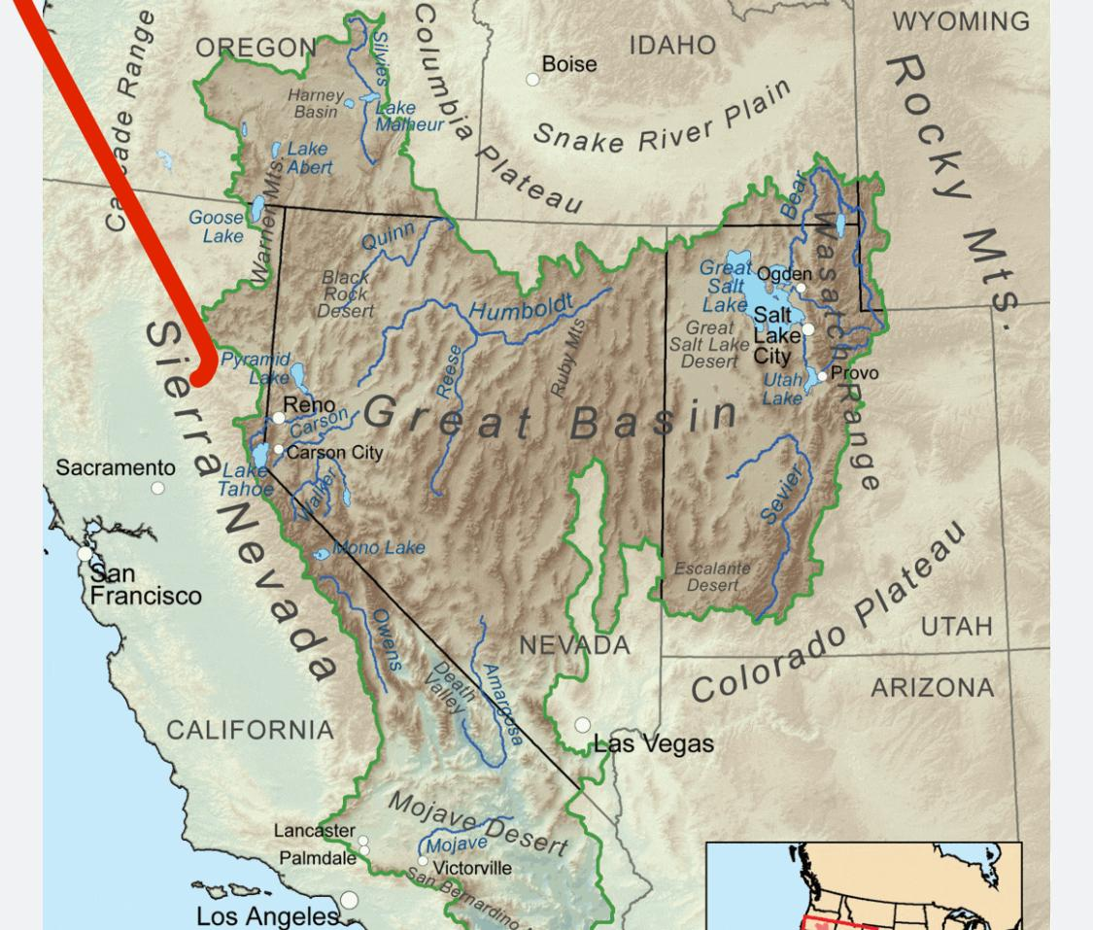
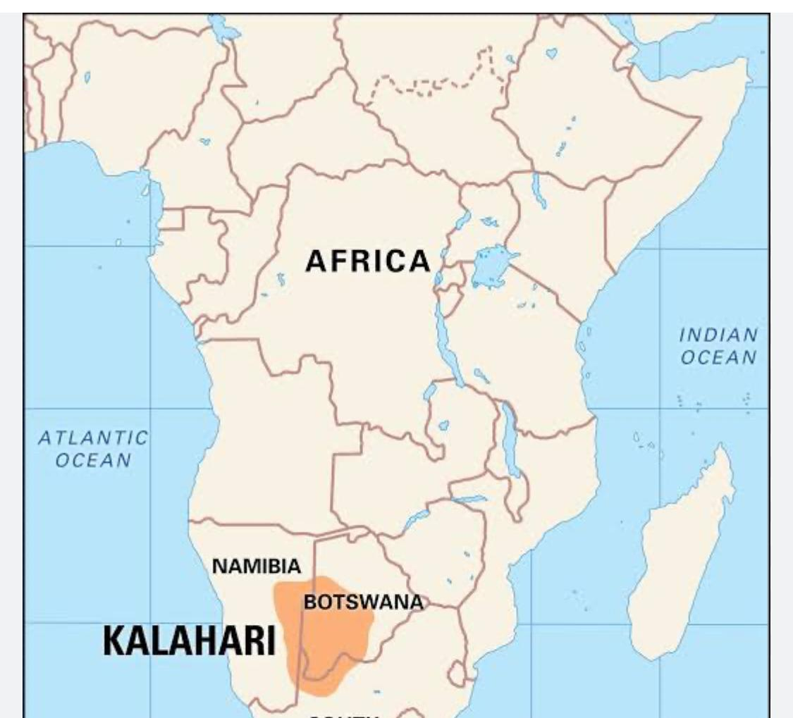
APSC Prelims 2025 Full Paper Analysis | GS Paper 1
Question
Explanation
Ans: B

Slide 82
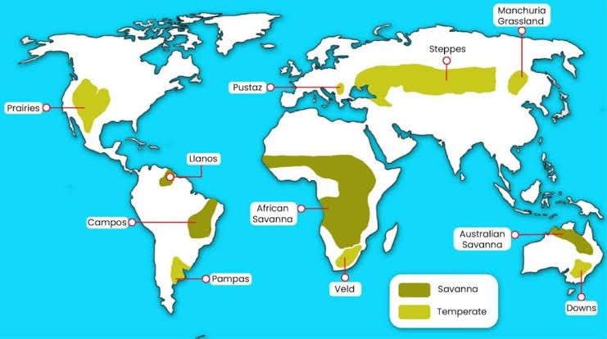
APSC Prelims 2025 Full Paper Analysis | GS Paper 1
Question
Explanation
Ans: A

Slide 83
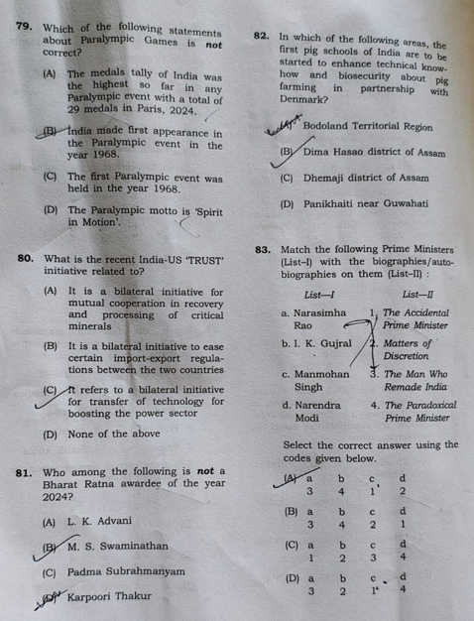

APSC Prelims 2025 Full Paper Analysis | GS Paper 1
Question
Explanation
Ans: C

Slide 84
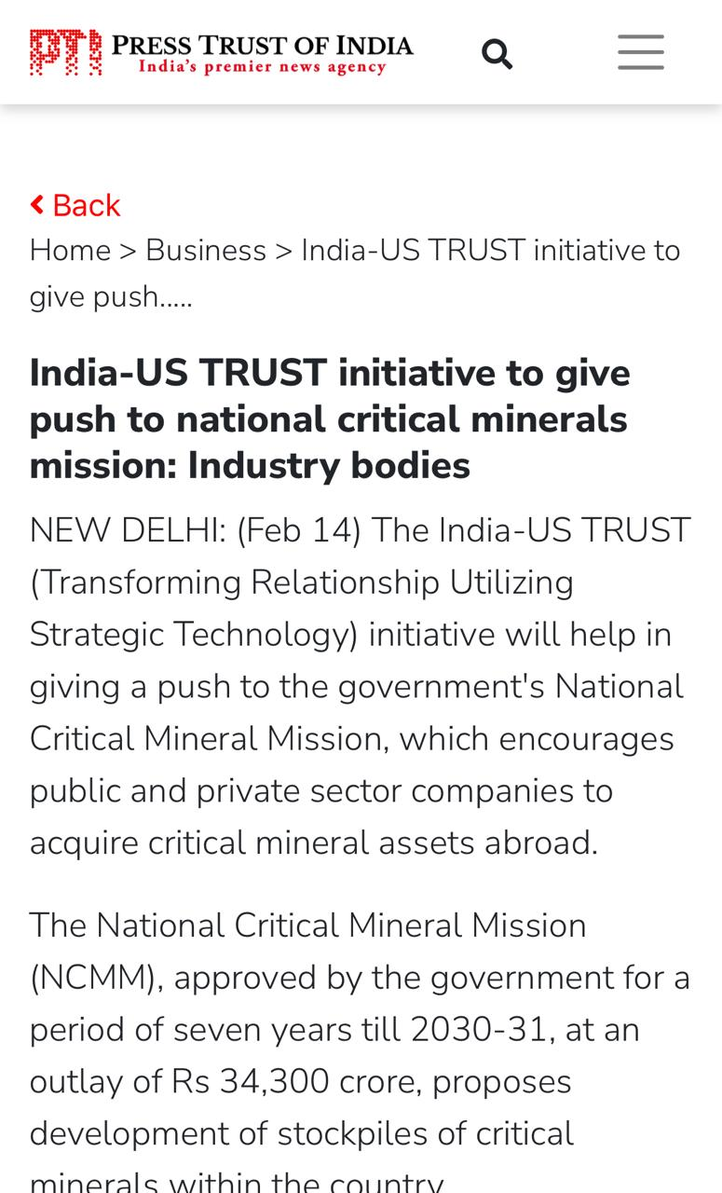
APSC Prelims 2025 Full Paper Analysis | GS Paper 1
Question
Explanation
Ans: A

Slide 85
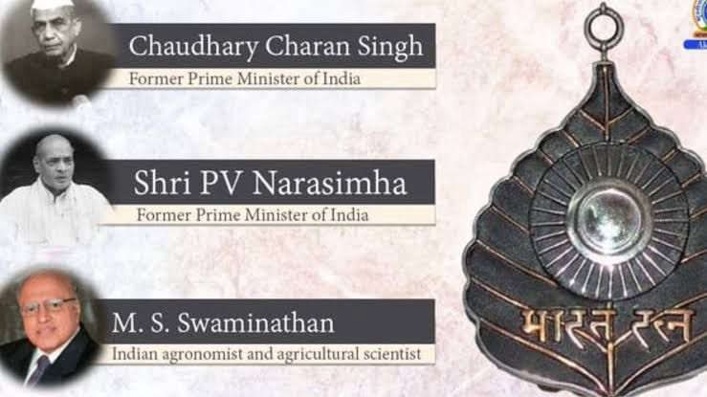
APSC Prelims 2025 Full Paper Analysis | GS Paper 1
Question
Explanation
Ans: C

Slide 86
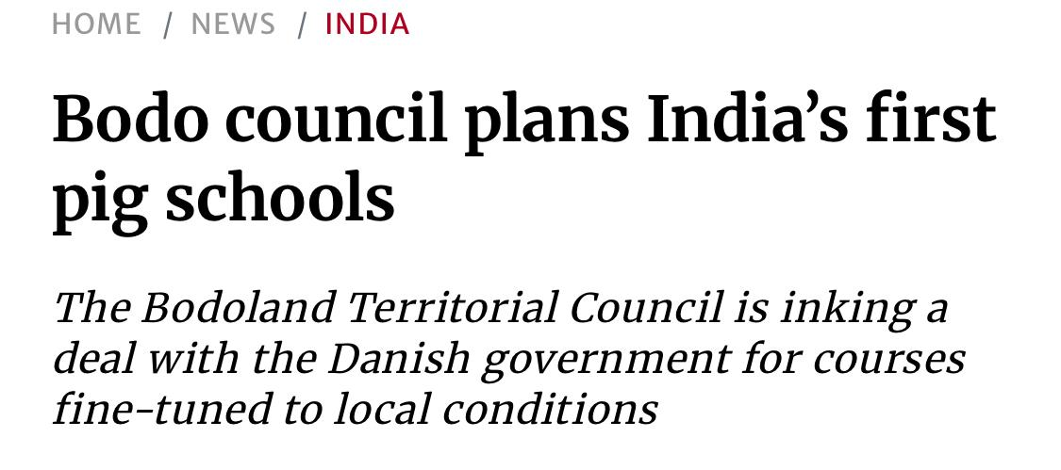
APSC Prelims 2025 Full Paper Analysis | GS Paper 1
Question
Explanation
Ans: A
https://www.thehindu.com/news/national/bodo-council-plans-indias-first-pig-schools/article67023651.ece/amp/

Slide 87
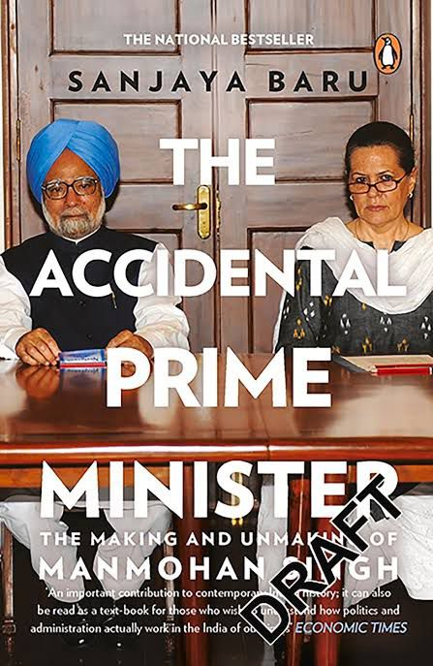
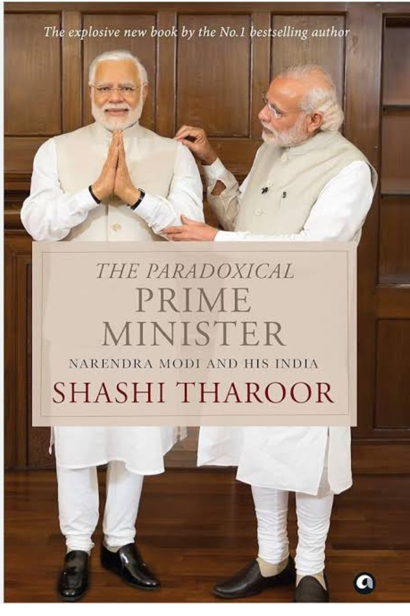
APSC Prelims 2025 Full Paper Analysis | GS Paper 1
Question
Explanation
Ans: D

Slide 88
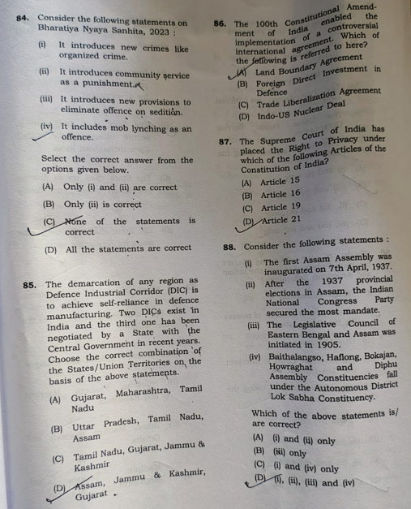
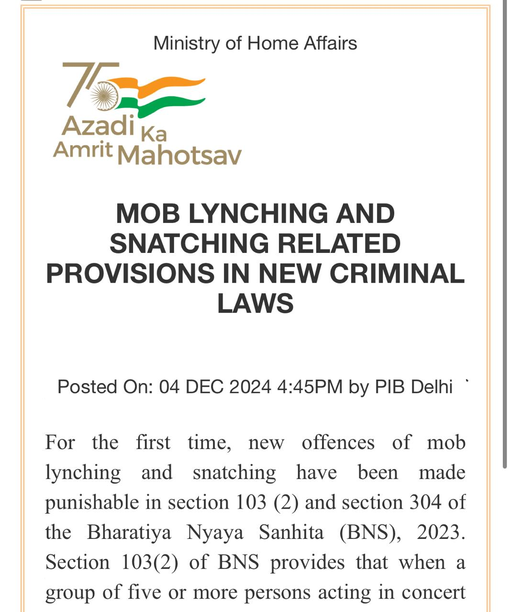
APSC Prelims 2025 Full Paper Analysis | GS Paper 1
Question
Explanation
Ans: D

Slide 89
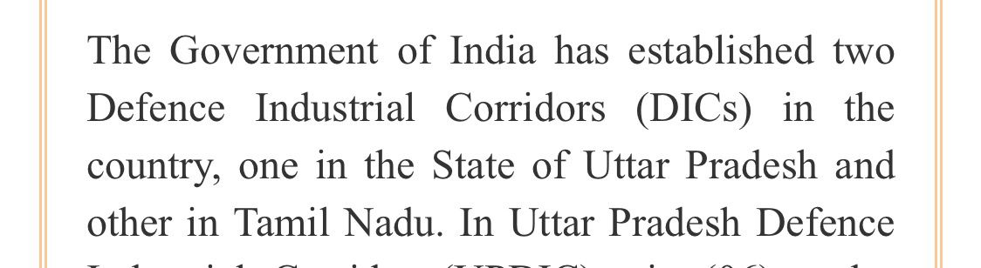
APSC Prelims 2025 Full Paper Analysis | GS Paper 1
Question
Explanation
Ans: B
https://www.pib.gov.in/PressReleaseIframePage.aspx?PRID=1913309

Slide 90
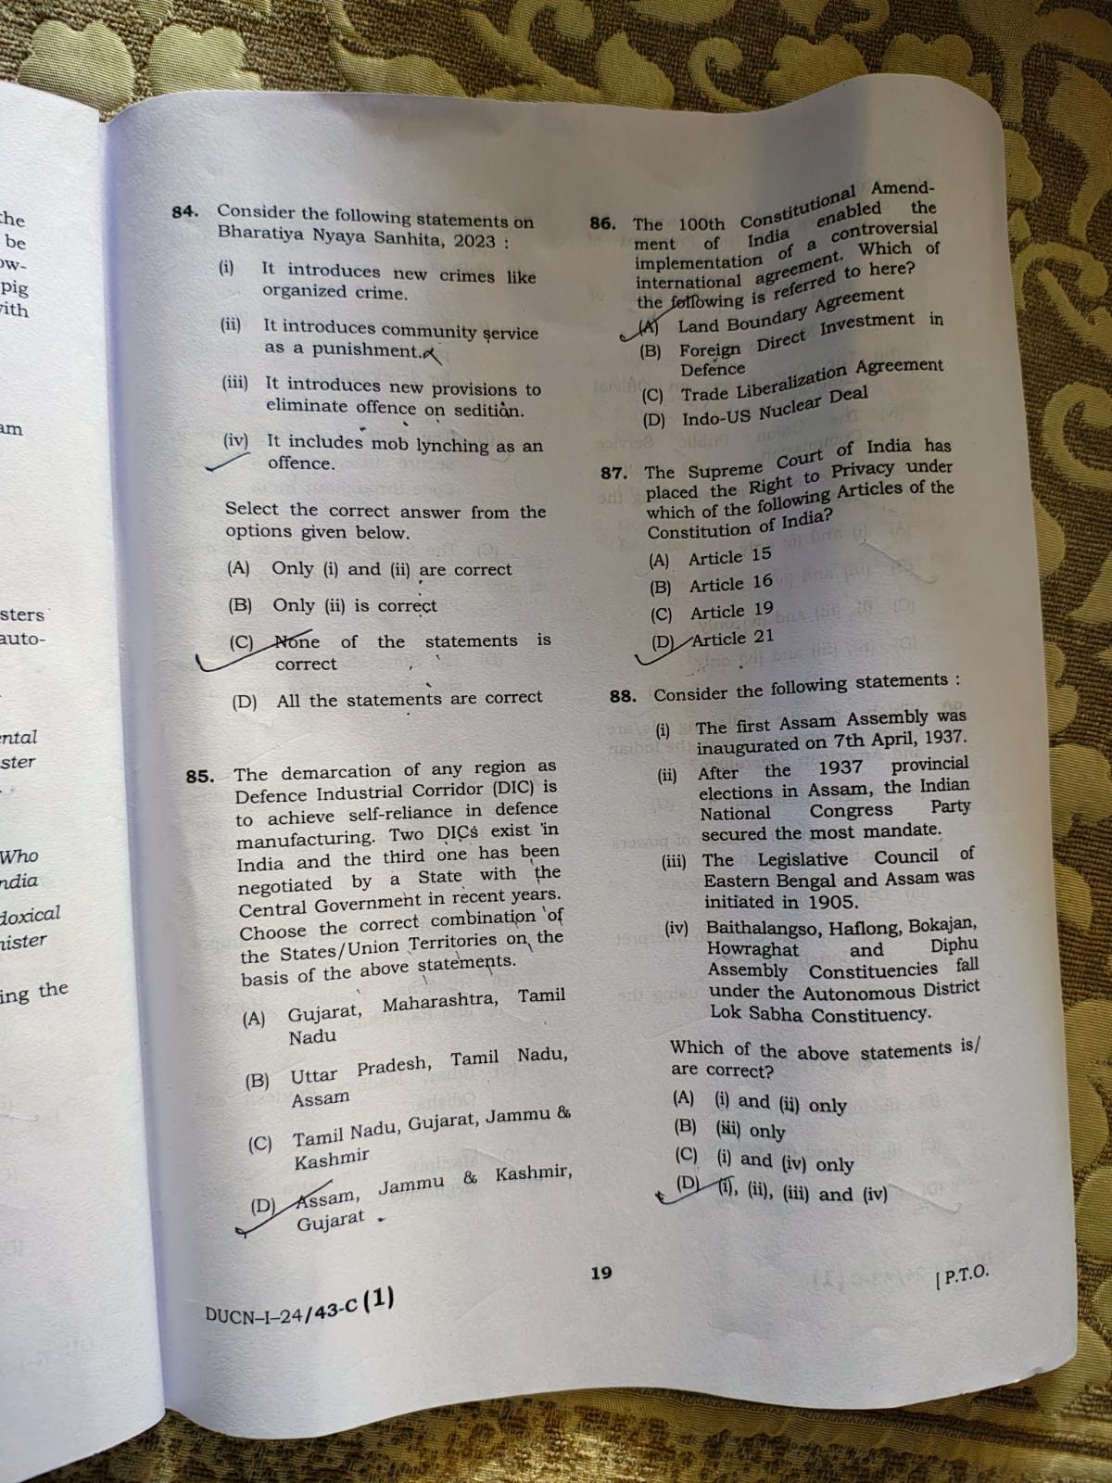

APSC Prelims 2025 Full Paper Analysis | GS Paper 1
Question
Explanation: The correct answer is (A) Land Boundary Agreement. Explanation: The 100th Constitutional Amendment of India was enacted in 2015 to ratify the Land Boundary Agreement (LBA) between India and Bangladesh. This agreement involved the exchange of enclaves (small pockets of land surrounded by the other country) along the border. The amendment was necessary because it required changing the territorial definitions within the First Schedule of the Indian Constitution.
Ans: A

Slide 91
APSC Prelims 2025 Full Paper Analysis | GS Paper 1
Question
Explanation
Ans: D
Article 21. The Supreme Court of India, in the K. S. Puttaswamy vs. Union of India case, recognized the right to privacy as a fundamental right under Article 21 of the Constitution, which guarantees the right to life and personal liberty

Slide 92
APSC Prelims 2025 Full Paper Analysis | GS Paper 1
Question
Explanation
Ans: D
(i) The first Assam Assembly was inaugurated on 7th April, 1937. Correct – This aligns with historical records. After the Government of India Act, 1935, provincial assemblies were formed, and the Assam Legislative Assembly was inaugurated on 7 April 1937.---
(ii) After the 1937 provincial elections in Assam, the Indian National Congress Party secured the most mandate. Correct – In the 1937 elections under the Government of India Act, 1935, the Indian National Congress emerged as the single largest party in Assam.---(iii) The Legislative Council of Eastern Bengal and Assam was initiated in 1905. Correct – The province of Eastern Bengal and Assam was created in 1905,
(iv) Baithalangso, Haflong, Bokajan, Howraghat, Diphu Assembly Constituencies fall under the Autonomous District Lok Sabha Constituency. Correct – These constituencies fall under the Autonomous District (ST) Lok Sabha Constituency in Assam.---

Slide 93
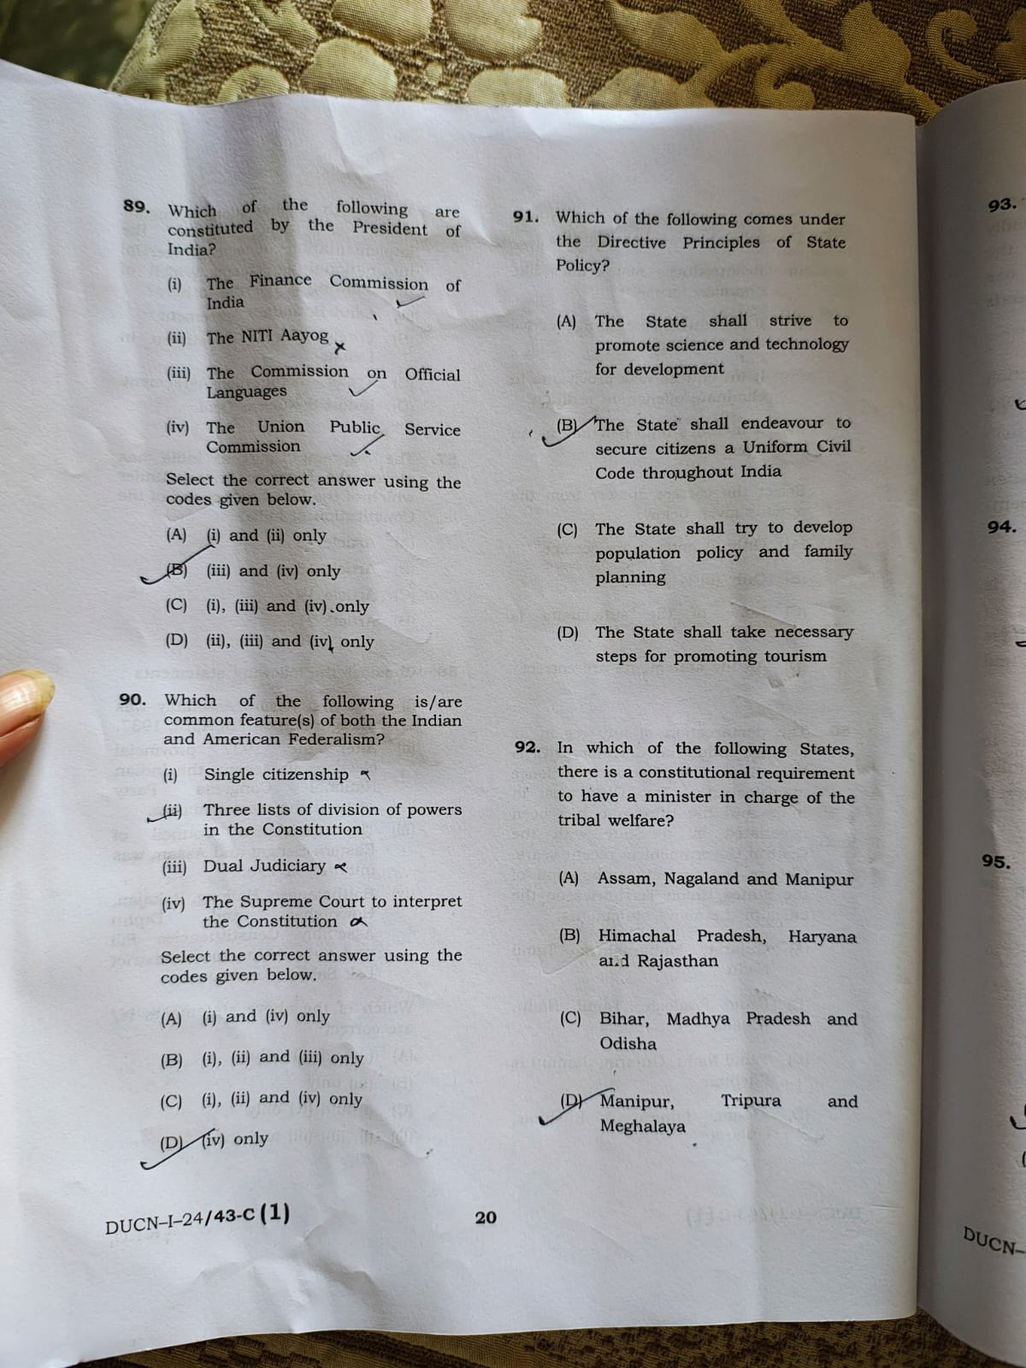
APSC Prelims 2025 Full Paper Analysis | GS Paper 1
Question
Explanation
Ans: C
(i), (iii), and (iv) only. Explanation: The Finance Commission: According to Article 280 of the Indian Constitution, the President of India appoints the Finance Commission

Slide 94
APSC Prelims 2025 Full Paper Analysis | GS Paper 1
Question
Explanation
Ans: D
(i) Single citizenship Not common India: Follows single citizenship (Indian citizenship only).USA: Follows dual citizenship (citizenship of the U.S. and of the individual state).

Slide 95
APSC Prelims 2025 Full Paper Analysis | GS Paper 1
Question
Explanation
Ans: B
(B) The State shall endeavour to secure citizens a Uniform Civil Code throughout India Correct Article 44 of the Constitution states:> “The State shall endeavour to secure for the citizens a uniform civil code throughout the territory of India.” This is a clear and direct Directive Principle of State Policy.

Slide 96
APSC Prelims 2025 Full Paper Analysis | GS Paper 1
Question
Explanation
Ans: C
The correct answer is (C) Bihar, Madhya Pradesh and Odisha. Explanation: Article 164(1) of the Indian Constitution states that in the states of Bihar, Madhya Pradesh, and Odisha, there must be a Minister appointed specifically in charge of tribal welfare.

Slide 97
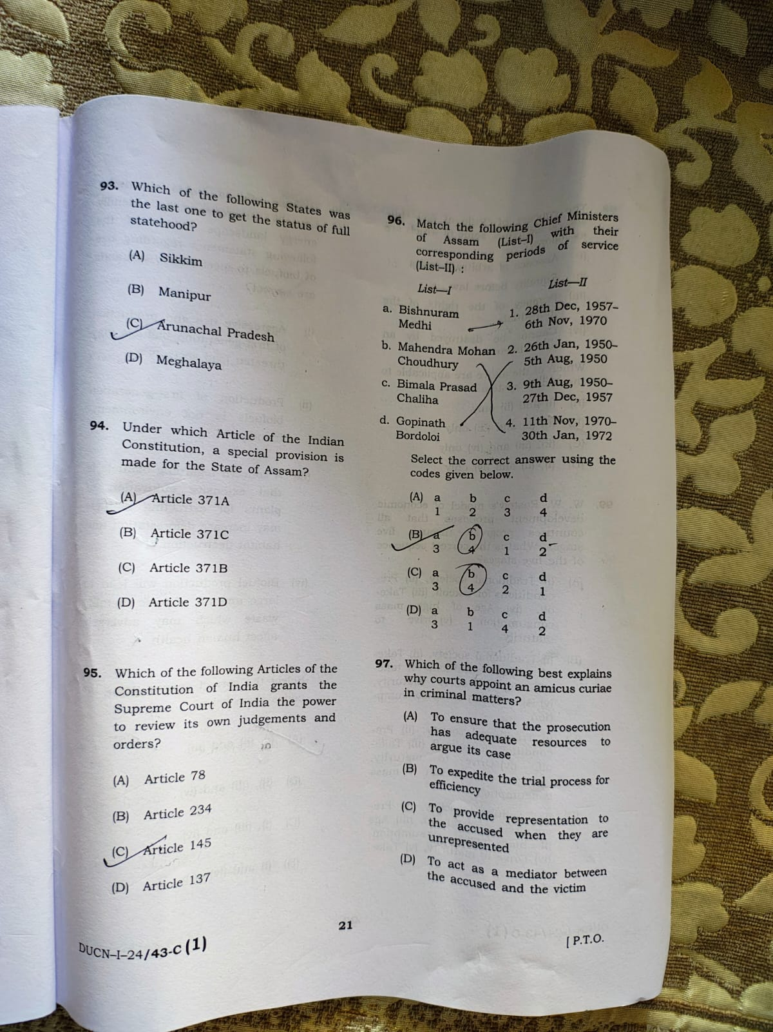
APSC Prelims 2025 Full Paper Analysis | GS Paper 1
Question
Explanation
Ans: C
(A) Sikkim Became the 22nd state of India on 16 May 1975.Before that, it was an Indian protectorate, and in 1974 became an associate state under the 35th Amendment. Later, the 36th Amendment Act gave it full statehood.---(B) Manipur Became a full state on 21 January 1972.---(C) Arunachal Pradesh Became a full-fledged state on 20 February 1987.---(D) Meghalaya Became a full state on 21 January 1972, same as Manipur.--- Correct Answer: (C) Arunachal Pradesh
It was the last among the options to get full statehood.

Slide 98
APSC Prelims 2025 Full Paper Analysis | GS Paper 1
Question
Explanation
Ans: C
Article 371B. Explanation: Article 371B of the Indian Constitution specifically deals with special provisions for the state of Assam. Key points about other articles mentioned in the options: Article 371A: Nagaland. Article 371C: Manipur. Article 371D: Andhra Pradesh and Telangana.

Slide 99
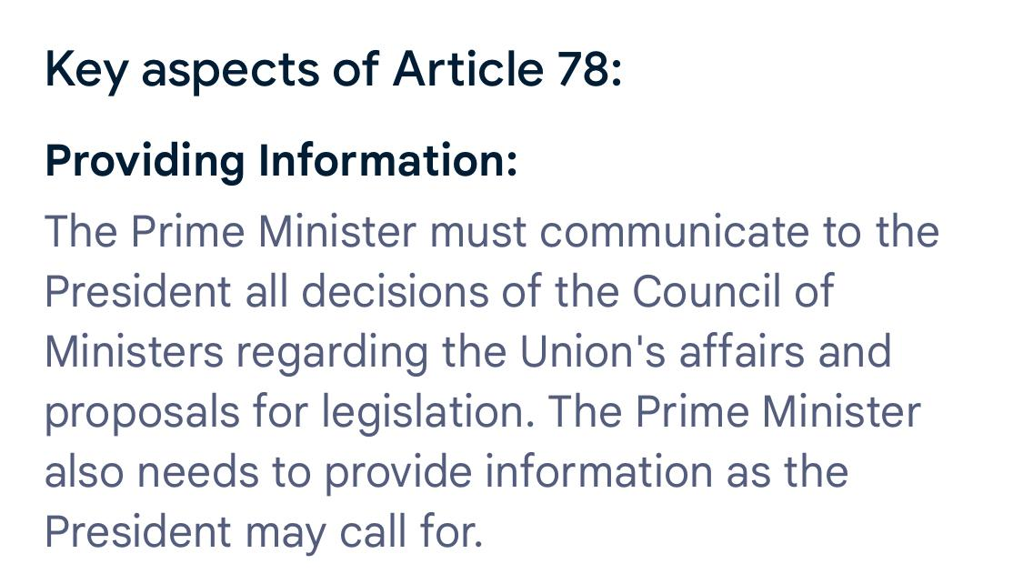
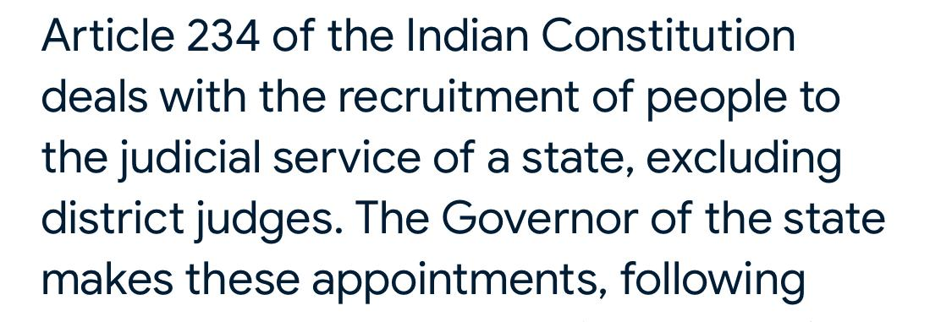

APSC Prelims 2025 Full Paper Analysis | GS Paper 1
Question
Explanation
Ans: D
Article 137 of the Indian Constitution deals with the review of judgments or orders by the Supreme Court.

Slide 100
APSC Prelims 2025 Full Paper Analysis | GS Paper 1
Question
Explanation
Ans: B
List-I (Chief Ministers) and their Correct Tenures (List-II):a. Bishnuram Medhi → (3) 9th August 1950 – 27th December 1957b. Mahendra Mohan Choudhury → (4) 11th November 1970 – 30th January 1972c. Bimala Prasad Chaliha → (1) 28th December 1957 – 6th November 1970d. Gopinath Bordoloi → (2) 26th January 1950 – 5th August 1950(Note: Bordoloi was also Premier before independence, but his post-independence CM tenure was Jan–Aug 1950)

Slide 101
APSC Prelims 2025 Full Paper Analysis | GS Paper 1
Question
Explanation
Ans: C
Amicus Curiae literally means "friend of the court." In criminal matters, an amicus curiae is often appointed by courts to: Assist the court by offering independent expertise or perspective. Ensure fair trial — especially when an accused has no legal representation due to poverty, lack of access, or other reason. This helps protect the rights of the accused and ensures justice is served in line with the principle of natural justice and Article 21 (Right to life and personal liberty) of the Constitution.

Slide 102

APSC Prelims 2025 Full Paper Analysis | GS Paper 1
Question
Explanation
Ans: D

Slide 103
APSC Prelims 2025 Full Paper Analysis | GS Paper 1
Question
Explanation
Ans: C
Traditional Society Economy based on subsistence agriculture and primitive tools.
Pre-conditions for Take-off Society begins to develop manufacturing and a more productive agriculture sector.
Take-off Rapid growth in a few economic sectors; industrialization begins.
Drive to Maturity Technological advancement spreads, economy diversifies.
Age of High Mass Consumption Economy shifts from production of heavy industry to consumer goods and services.--- Correct Order: Traditional Society → Pre-conditions for Take-off → Take-off → Drive to Maturity → Age of High Mass Consumption---
Correct Answer: (C) (i) Traditional society, (ii) Pre-conditions for takeoff, (iii) Take-off, (iv) Drive to maturity, (v) Age of high mass consumption

Slide 104
APSC Prelims 2025 Full Paper Analysis | GS Paper 1
Question
Explanation
Ans: A
(i) Aggressive use and production of first-generation biofuels may threaten food security
Correct –First-generation biofuels are made from food crops (e.g., corn, sugarcane). Their large-scale use diverts food crops for fuel, which can raise food prices and threaten food security.
(ii) Production of first-generation biofuels is not environment-friendly Partially correct but nuanced –While biofuels reduce carbon emissions compared to fossil fuels, first-gen biofuels can have negative environmental effects like: Excessive water use
Use of fertilizers and pesticides Land-use changes So, overall, their environmental friendliness is debated, but it's fair to say that they are not entirely green.
(iii) A concern regarding biofuels is that extensive cultivation of plants for extracting biofuels may increase deforestation and habitat destruction
Correct –To grow more biofuel crops, forests may be cleared, leading to deforestation, biodiversity loss, and habitat destruction.
(iv) Biofuel production will lead to large amount of toxic metallic waste which may adversely affect human healthIncorrect –Biofuel production does not typically generate toxic metallic waste. This concern is more relevant to certain industrial or mining processes, not agricultural-based biofuel production.
Correct Answer: (A) (i), (ii) and (iii)

